Slide 1

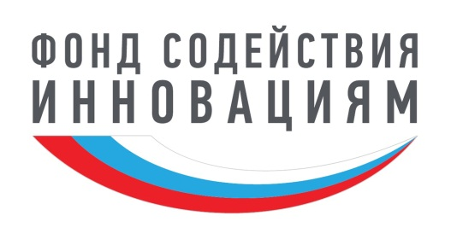

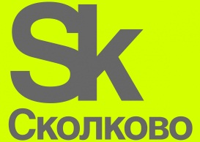

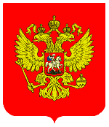
Lipetsk city, Lipetsk region, the RF
Development of manufacturing technique and innovative equipment for axisymmetric induction heating of metalware with the discrete cross-section area
Project leader:
Candidate of Engineering Sciences, Director General of “System48 Scientific Production Enterprise”
Sergei Titov

Slide 2
Introduction
Manufacturing of continuous power efficient equipment that ensures the axisymmetric heating to the given depth for the heat treatment of ball-shaped products without oxidation and decarburization is extremely urgent for a number of productive industries, in particular in the mass productions of grinding bodies for ore mining and processing mills and cement plants, frictionless bearing balls and valves in the hydraulic systems, including high-wear-resistant balls in working barrel back pressure valves for oil production, etc.
The induction method with direct and high speed (seconds – fractions of a second) electric energy to heat energy conversion which is notable for the simplicity in control of temperature and depth of heat meets best of all this set of heating characteristics required by the industry. It permits the optimal combination of high surface hardness of products (back-to-back endurance) with rather yielding core (shear strength) after quenching and tempering.
However, despite of all the known advantages of this method nowadays its applicability with the required axial symmetry of heating is limited in the world mainly by the products of continuous section or similar to it.
The project under development resolves the issue raised.

Slide 3

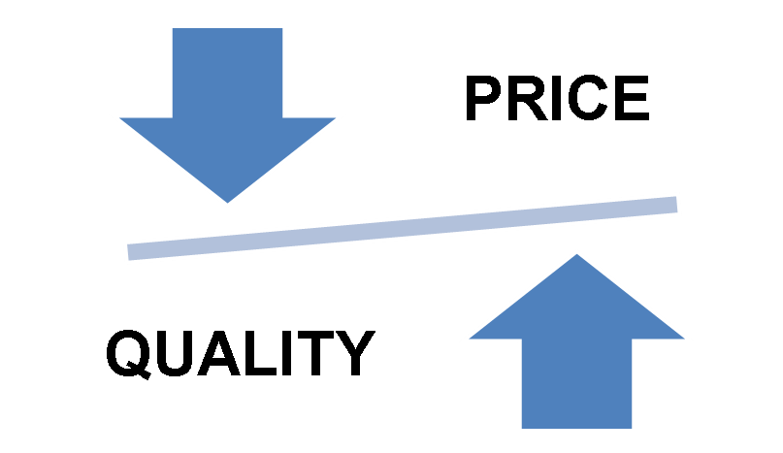
PROJECT TASK
Commercialization of the innovative technology which allows for the increased surface hardness, strength, wear resistance of metal balls with their cost reduction at the same time
Product - Technology

Slide 4
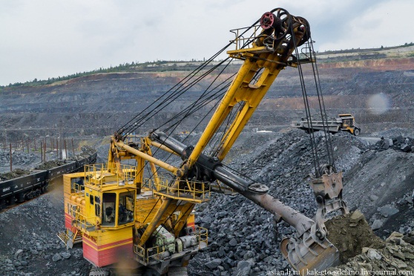
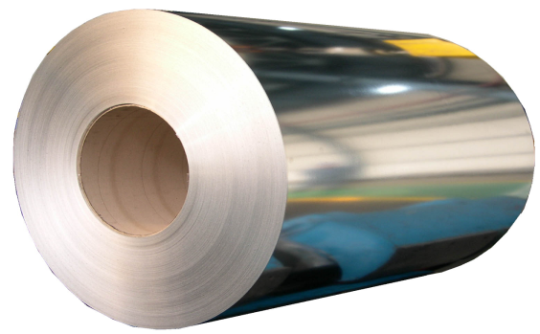
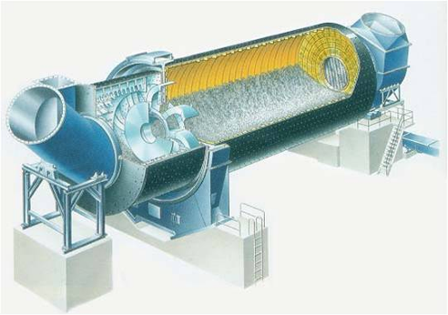
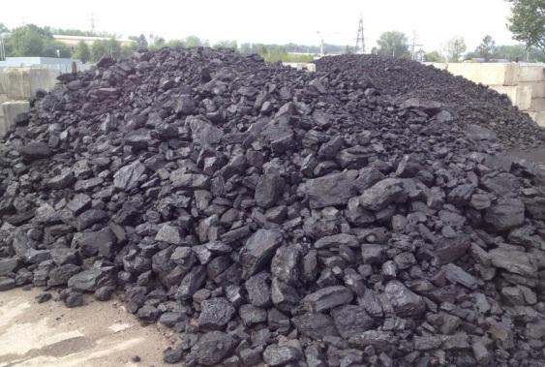
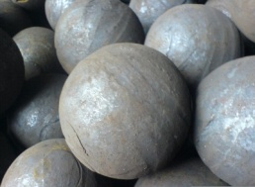
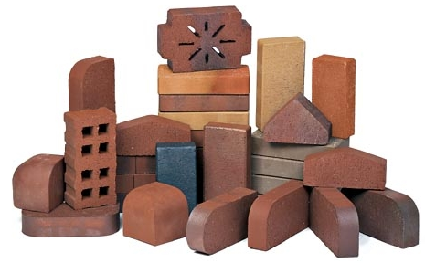

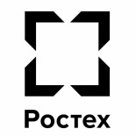

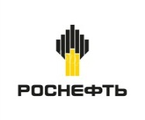
CONSUMERS OF METAL BALLS
Iron-ore concentration in the metallurgy (grinding balls in ball mills)
The building sector: the production of silicates, cement
(Clinker grinding with grinding balls in ball mills)
Bearing balls
Heat treatment
Oil production
(working barrel back pressure valves )
High-tech methods to give the desired properties to spherical surfaces by means of symmetrical thermal diffusion alloying (chromium, titanium, boron etc.)

Slide 5

PATTERN OF CONSUMPTION OF GRINDING BALLS IN THE RF
The main consumer of grinding balls in Russia is an iron-ore sector, deliveries of which occupy 40% of the market
The pattern of consumption of grinding balls
in the Russian market (2018, %)
1
Mineral resource industry
(ore reduction) 85%
Other ores¹
Aluminium
3%
Gold
17%
2%
Other (copper und nickel)
2
Copper und nickel
17%
UMMC
Cement industry
(Clinker grinding) 13%
9%
Norilsk Nickel
16%
Other (iron)
4%
EVRAZ
Iron
40%
7%
Severstal
3
10%
NLMK Group
Energy sector
(breakage of coal for coal-fired thermal power plant) 2%
14%
Metalloinvest
Cement
13%
NLMK Group consumes ~9% of grinding balls in the RF market
Coal
2%
1. Apatites, uranium, ores for the production of refractory products, etc.
Source: NLMK Group (RZhD database), Rosstat, data from companies and industry associations, the analysis made by A.T. Kearney

Slide 6

TCO* FACTOR ANALYSIS OF GRINDING BALLS**
1.Consumption of balls 51%
1.1.1 Chemical composition
1.1.2 Presence of internal defects
1.1.3 Volume hardness
1.2 Consumption record of balls 1%
1.1 Quality of balls 50%
1.1.4 Quality of surface
1.1.5 Geometric ball shape
1.1.6 Ball diameter
Total Cost of Ownership of balls
3.1 Electricity metering
2.2 Suppliers
2.2.1 Incoming control
3. Power consumption for grinding 8%
2.Price of balls 41%
*- Total Cost of Ownership
** - The used tool is Ishikawa diagram (It is often called “a fish bone” in the Russian literature)

Slide 7
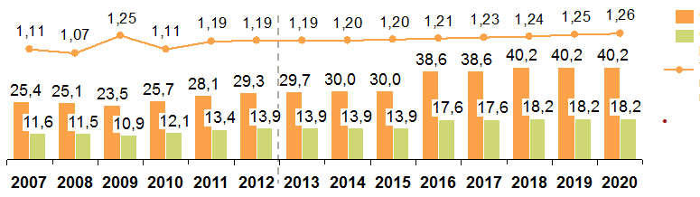
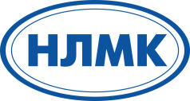
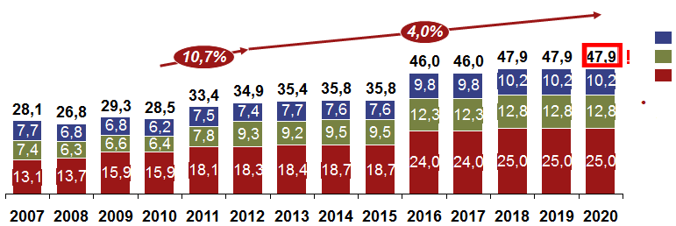
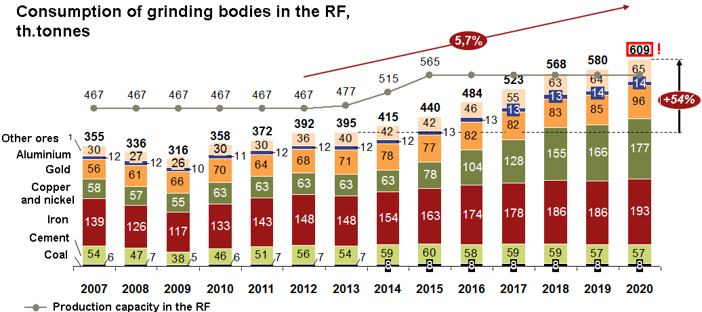
PROBLEM OF HIGH TOTAL COST OF OWNERSHIP (TCO) OF GRINDING BALLS (ANALYTICS)
Ore processing volumes and the consumption rate of grinding bodies
Ore processing volume, mln. t
Ore concentrate production volume , mln. t
Rate of use of grinding bodies per one tonne of the processed ore, kg/t
TCO of grinding balls in “SGOK” ОАО
In the course of further field development it is expected to have a decrease in the concentrate specific yield from a tonne of in-process ore
Consumption of balls 51 %
(poor quality of balls)
Consumption volume of grinding bodies, th. tonnes a year
Grinding balls, D 40 mm
Grinding balls, D 60 mm
Grinding balls, D 100 mm
Price of balls 41 %
(high prime cost of balls)
The rate of use of grinding bodies per one tonne of in-process ore will keep on growing¹ because of the gradual decline in ore preparation characteristics
Power consumption for grinding 8 %
1. With disregard for a possible effect from the change of a supplier and/or a type of grinding bodies
Source: SGOK, the analysis made by A.T. Kearney
Taking into account a number of large-scale projects in copper, iron and gold a market growth of grinding bodies can be expected by 2020.
Annual parameters | “SGOK” ОАО | The RF
Consumption, th. tonnes | 47.9 | 609
Costs, mln. Rub. | 1,916 | 24,360
ТСО, mln. Rub. | 4,673 | It depends on the branch
Loss of profit by 1 % of TCO reduction, mln. Rub. | 46,7 | It depends on the branch

Slide 8
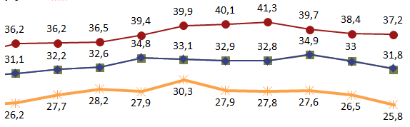
PRICE BEHAVIOUR OF GRINDING BALLS , MARKET SIZE
The RF market, bln. Rub.
In 2015-2017 the price behaviour of grinding balls reflected the change of prices for steel with a time lag of 3-6 months
PAM
23,7
TAM
Historical price behaviour* for grinding balls,
th. Rub. / t
20,1
SAM
2,1
SOM
0,73
The world market, bln. Rub.
PAM
125,8
Steel balls, D 100 mm, hardness of group 3
Steel balls, D 60 mm, hardness of groups 2-3
TAM
Steel balls, D 60 mm, hardness of groups 2-3
Quoted prices of Billet FOB Black & Baltic Sea ports
export
108,2
SAM
Apart from the beginning of 2015 cast-iron balls were consistently cheaper than the steel ones
by ~3,500-5,500 Rub/t
37,3
SOM
Source: SGOK of “NLMK” PAO, the analysis made by A.T. Kearney
?**
*- the prices correlate with the prices for raw materials (metal wheel)
**- it is not planned to enter the world market at the first stage

Slide 9
PRODUCERS OF METAL BALLS IN THE WORLD
(TRADITIONAL HEATING TECHNOLOGY FOR HEAT TREATMENT)
The global leader Arrium owns ~30% of the market, but it only operates in the markets of North and South America and Australia
World market structure of grinding balls
There are four leading global players which operate with the works in different regions of the world:
Arrium¹ : 7 works in South and North America, Australia and Indonesia, the global market leader in facility size (29% of the market)
Magotteaux : 13 works in Europe, North and South America, Asia and South Africa
AIA Engineering² : production in India and active supplies to South and North America, Australia, South Africa and Europe
ME Elecmetal : 5 works in South and North America
78 regional producers which considerably differ in the production output and the skill level
GIS leading producers: EVRAZ, METINVEST and UzMetKombinat (Uzbeksteel) make the top 10 of the largest world producers according to the facility size
Size of production facilities,
th. t
Total = ~4,500 th. t
Other
producers 1697
Arrium¹ 1290
29%
7%
Magotteaux 308
3%
6%
EVRAZ 250
Donhad 140
3%
4%
Gerdau 140
AIAE (Vega) 200
ME Elecmetal 154
METINVEST 170
UzMetKombinat 170
Names before 2012: Moly-Cop and OneSteel
Trade mark in export markets: Vega
Source: Arrium, SPARK, KOMPASS, Capital IQ, the analysis made by A.T. Kearney

Slide 10
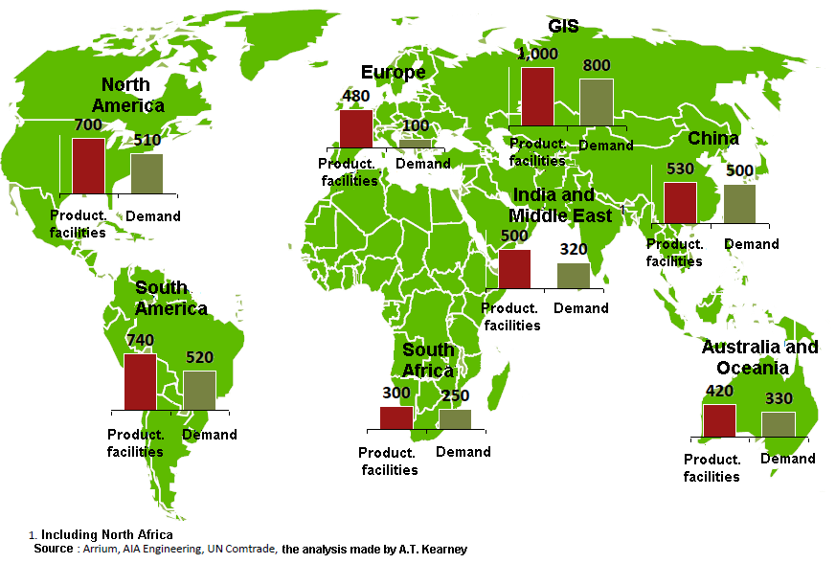
GEOGRAPHY OF PRODUCERS AND CONSUMERS OF GRINDING BALLS IN THE WORLD
The global market of grinding balls makes up ~3 bln. t. and grows by 4-5% a year, but its facilities are only ~70% utilized
Regional balances of grinding bodies
(2017, th.t)
The world market size of grinding bodies makes up ~2.9 bln.t., 90% of which is consumed by the mining sector
The key regions of consumption are GIS, South and North Americas, China and Australasia
In 2014-2017 the annual market growth rates made up 4-5% a year
The production of grinding bodies is mainly concentrated in the regions of their consumption; the total capacity utilization makes up ~70%
India and China are the largest exporters of grinding bodies, exporting respectively 60 and 30 th. t a year

Slide 11
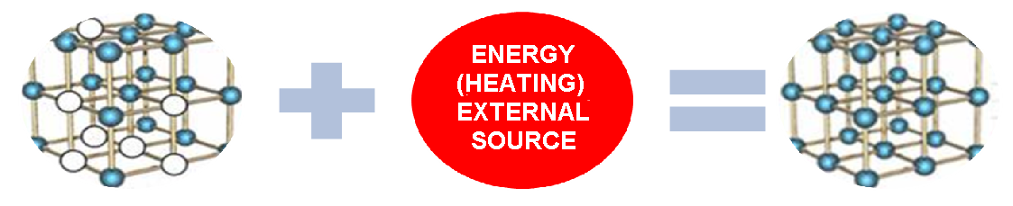
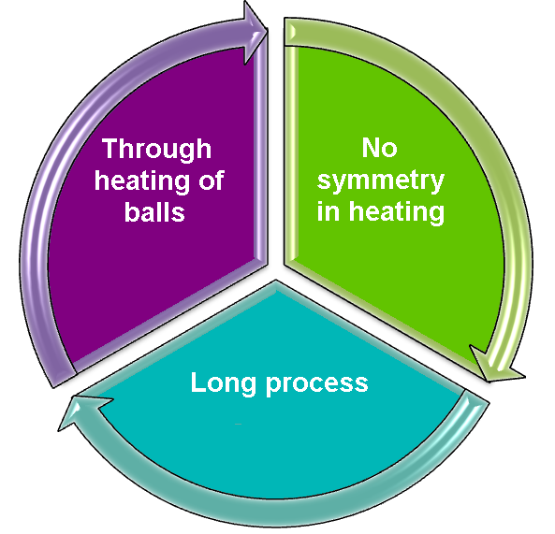
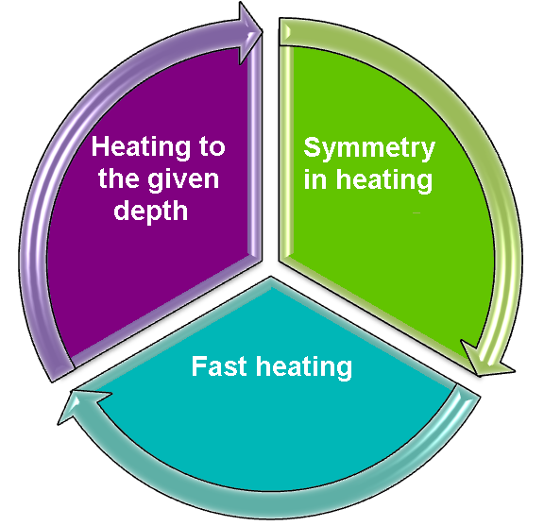
QUALITY OF HEAT TREATMENT MEANS QUALITY OF BALLS
METAL STRUCTURE BEFORE TREATMENT
METAL STRUCTURE AFTER TREATMENT
TRADITIONAL APPROACH
PROPOSED APPROACH
снижение качества термообработки
HEATING IN GAS FURNACES or
RESISTANCE FURNACES (heating elements)
Induction heating HFC!

Slide 12
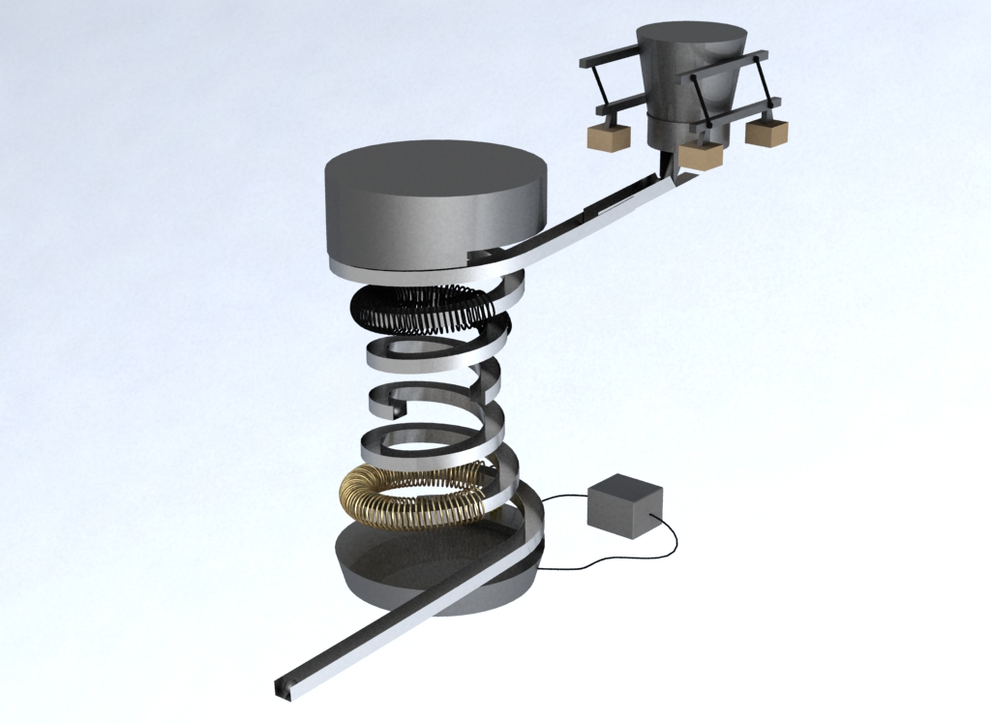
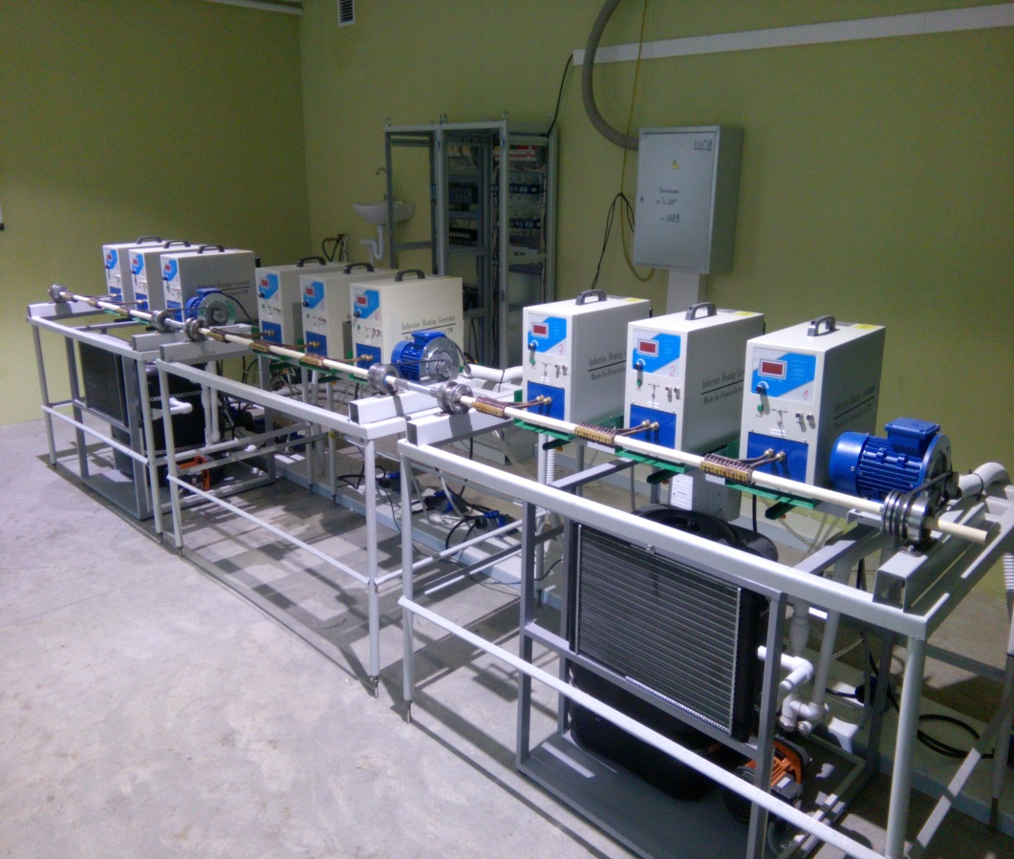
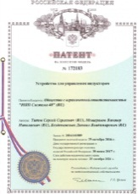
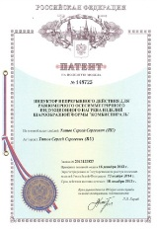
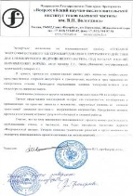
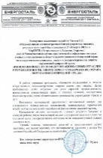
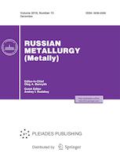

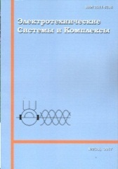
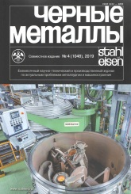
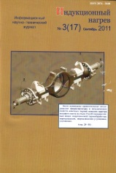
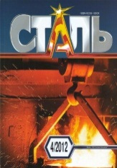
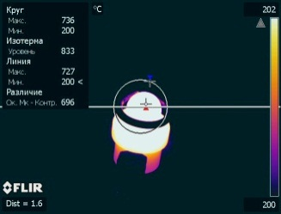
INNOVATION HEATING TECHNOLOGY FOR HEAT TREATMENT
MINIMUM VIABLE PRODUCT (MVP)
THE AXISYMMETRICAL BALL ROTATION IN THE ENVIRONMENT WITH ELECTROMAGNETIC FIELD
CONTROL OF
TEMPERATURE AND
DEPTH OF HEATING
A round workpiece
The cross-rolling mill
The conveyor
The proposed induction plant
The hardening plant
Heat-treatment cell
OUTPUT
INPUT – STAGE 1
It is possible to integrate into the existing processing lines of manufacturing companies!

Slide 13
ADDITIONAL COST OF INNOVATION TO THE CONSUMER
The application of the proposed technology makes it possible to have a unique double effect: improvement in quality of grinding balls and cutting of their production costs at the same time, what will finally permit the ТСО of grinding balls to be considerably reduced
TCO reduction of grinding balls by 23.3 %
(about 40 euro cents per tonne of processed ore)
cutting of the production costs by
7.2 %
Increase of service
life up to
1.6 times
Increase of the plant coefficient of efficiency (direct heating of the ball material with electromagnetic field energy)
AXISYMMETRIC heating of the ball material is possible to the given depth
Surface heating of the ball to the given depth
(energy is not consumed for the core heating of the product)
The effect of SHEAR STRENGTH is achieved: it is possible to get a yielding core of the ball
High-speed heating (there is no need to consume energy for hours)
It is possible to ensure ZERO OXIDATION AND DECARBURIZATION as a result of high heating rate

Slide 14
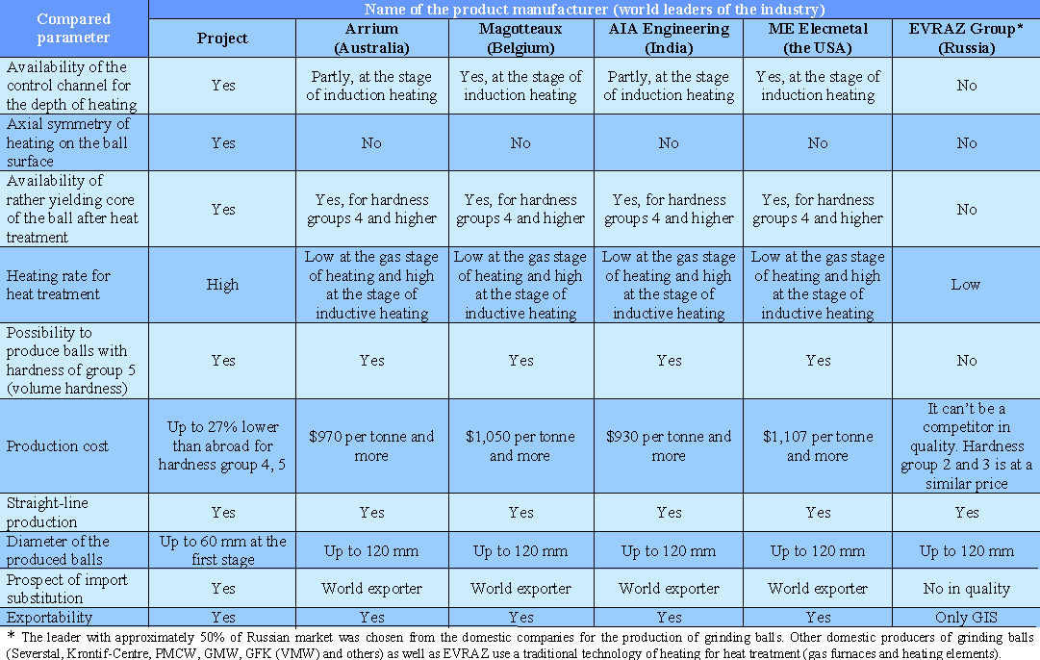
COMPARISON OF THE PRODUCT TECHNICAL AND ECONOMIC CHARACTERISTICS TO THE WORLD COMPETITORS

Slide 15



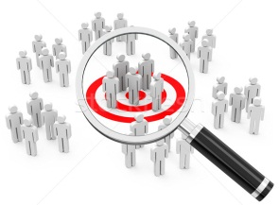


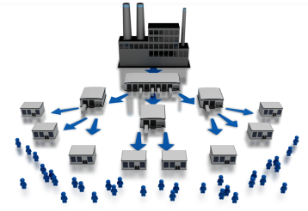

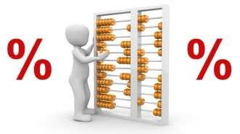
PROJECT BUSINESS MODEL*
KEY PARTNERS
KEY ACTIVITIES
VALUE PROPOSITIONS
CUSTOMER RELATIONSHIPS
CUSTOMER SEGMENTS
Iron and steel enterprises (including the product dealers): deliveries of round workpieces)
1) Mining and processing integrated plants;
2) Building sector (production of silicates, cement);
3) Ball bearing sector (frictionless bearing balls);
4) Oil production (working barrel back pressure valves);
5) Heat treatment (High-tech methods to give the desired properties to spherical surfaces by means of symmetrical thermal diffusion alloying (chromium, titanium, boron etc.)
Production of metal balls of high quality with TCO reduction for the customer
1) Personal support;
2) Generating of joint value proposition
Additional income of the enterprises that consume the output product as a result of TCO reduction of the delivered metal balls
CHANNELS
KEY RESOURCES
Human resources;
2) Intellectual property (patents, innovative solutions): intangible assets;
3) Material resources (equipment (HFC inductors), a building (to install the production line), an office, tools and components and etc.);
4) Financial resources (physical cash and non-cash money);
5) Raw materials.
It is planed to arrange direct and indirect sales of the product to the customers
COST STRUCTURE
REVENUE STREAMS
Fixed costs (salaries and wages of the employees, rent price of the premises, depreciation charges, contributions to different social funds and etc.);
Raw materials and energy;
Customer acquisition costs.
Sales of licenses to manufacture and run the equipment under development;
Sales of the equipment under development;
Disposal of metal balls.
* - in compliance with the methods of А. Osterwalder

Slide 16
COMMERCIALIZATION PLAN FOR PROJECT OUTPUT
R&D
Pilot lot production of metal balls
Disposal of the pilot lot of balls to the consumer
Remarks made by the first consumer
Pilot plant
Production
No
1
Updating of R&D results
Yes
Updating of the pilot plant
Yes
Pilot lot production of metal balls for “Severstal” PAO*
Disposal of the pilot lot of balls to “Severstal” PAO*
Remarks made by “Severstal” PAO*
Arranging supplies of metal balls inside “Severstal” PAO*
No
1
2
Complete satisfaction of demand of “Severstal” PAO* in quality of metal balls
Production distribution to integrated iron-and-steel works from other RF regions
Diversification of market outlets
2
3
«Exit» strategy implementation
(sale of technology to one of the powerful players in the market)
Entrance to the foreign market outlets of the product
3
Cost efficiency indexes of project implementation (production)
Investment stage, years | Project cycle, years | NPV, mln. euro | IRR, % | n_{ок}, years | ROI
2 | 5 | 17,4 | 81.3 | 2.7 | 3.8
* - or another iron and steel company, for example, «NLMK» PAO

Slide 17


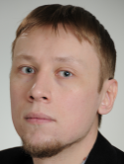

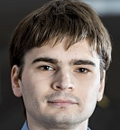
PROJECT TEAM
Chief engineer
Accountant
Project leader as Director
Senior scientist
Manager of “marketing” department
Candidate of Historical Sciences,
He has a management experience in a joint Russian-American project; he is a leader of projects in the development of electronic interaction system between the state and the society (the system of Multifunctional centres in Lipetsk region); an initiator and a leader of a number of IT projects for the regional authorities; he provided two electoral campaigns of Lipetsk city head with the sociological support.
Candidate of Engineering Sciences, an engineer at the Process Flow Automation Department of “Novolipetski metallurgicheski kombinat (NLMK)” PAO. He has a programming skill with such industrial controllers as Siemens Simatic Series 200/300/400/TDC, Schneider Premium/Quantum in the languages standardized by IEC 61131-3. He developed projects for the human-computer interface tools based on Siemens WinCC/WinCC Flexible and Schneider Electric Citect systems. He has an experience in design and adjustment of electrical drives of different manufacturers (Siemens: Simoreg, Simovert, Micromaster, Sinamics, Schneider Electric: Altivar 31,71, Emerson Unidrive SP, Mitsubishi FR, Baumuller bMax 4400).
Doctor of Engineering Science, full professor, Head of the Department of Electric Drives at FSBEI HPO “Lipetsk State Technical University". He is experienced in commercialization of 9 inventions. He participated in R&D as an academic adviser and an inventor of their underlying ideas. He is a full member of the International Academy of Natural Science and the Russian Academy of Quality Problems.
The project leader is a Candidate of Engineering Sciences; an inventor of the project idea; a many-time contestant and prize winner of prestigious innovation competitions. He got a workout under the specialists’ supervision from McKincey and Company (in particular in Germany). He has raised investment for the project at the total amount of about 8 mln. Rub., including from the non-budget sources. He has a successful collaborative experience with the regional authorities.

Slide 18
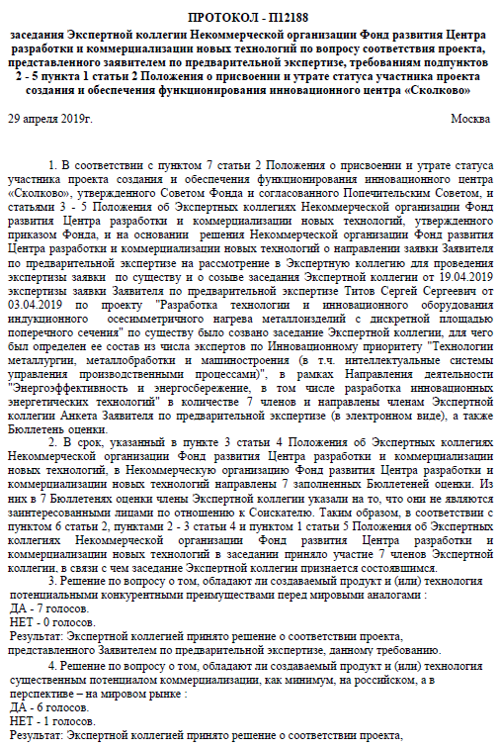
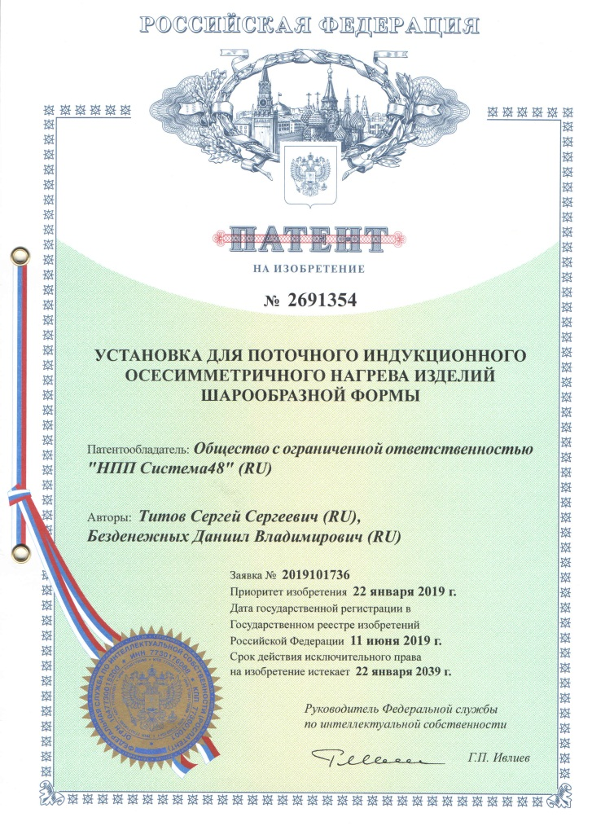
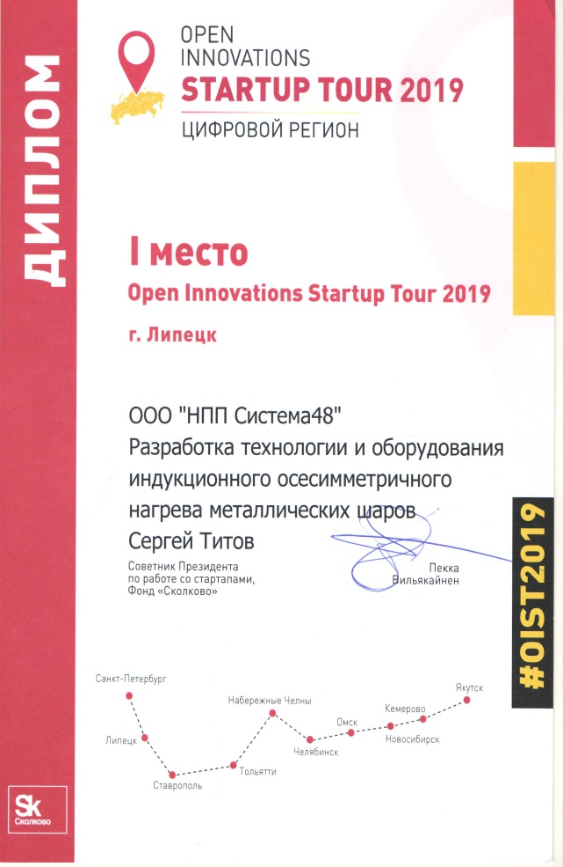

Steps for 2 months 2019
The funds were obtained
Sk
The examination was undergone
Sk
The international patent process under the PCT was started
on April 10
on April 29
on May 20
“System48 Scientific Production Enterprise” Company Limited (ООО), room 2, building A, 13 ul.Pushkina, 398001, Lipetsk city,
Tel.: +7 (904) 690 2601, e-mail: main@system48.ru, PSRN: 1164827055645, TIN/RVC: 4826123123/482601001, Settlement account No.: 40702810902930001612 set up in “ALFA-BANK” AO, Moscow city branch, TIN: 7728168971, PSRN: 1027700067328, RCBIC: 044525593, Loro account: 30101810200000000593

